Slide 1
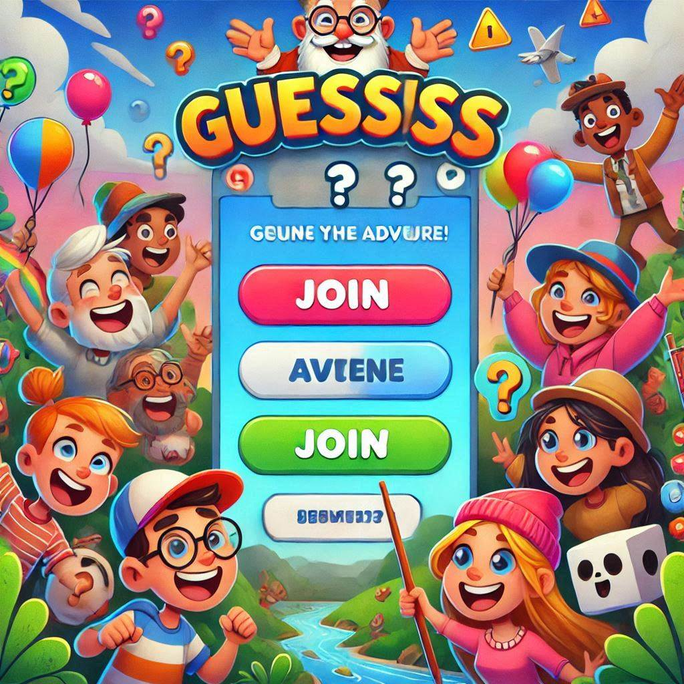
Guess Game Online

Slide 2
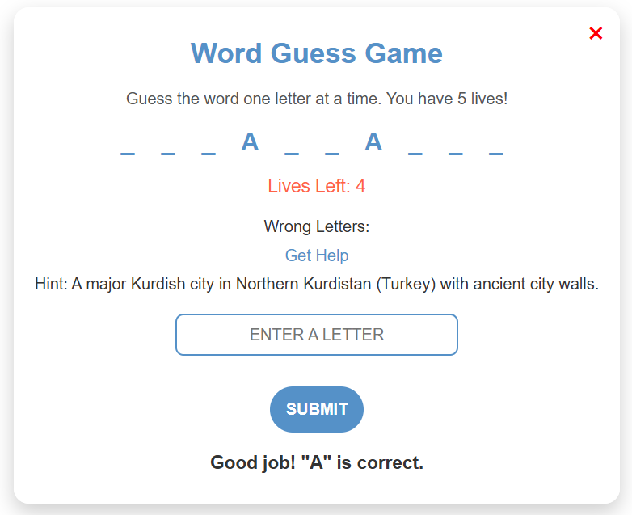
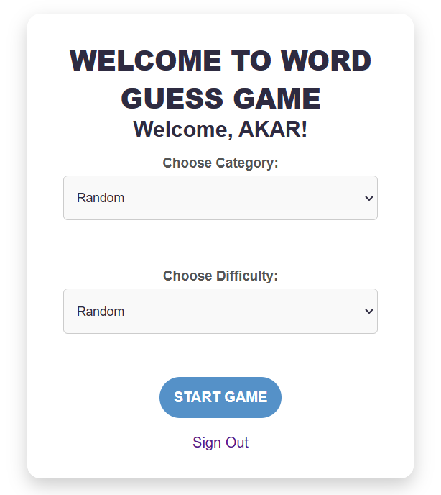
Introduction
Overview: A web-based game that allows users to guess words from various categories and difficulty levels.
Key Features:
User authentication (login/signup).
Word guessing game with dynamic categories and difficulties.
Real-time score tracking and leaderboard.
Technology Stack:
Frontend: HTML, CSS, JavaScript.
Backend: Flask (Python), MySQL (Database).
Data Structures: Hash Tables, Arrays, Queues, Sets.
.

Slide 3
Problem Statement
Efficiently manage user authentication, game progression, and real-time leaderboard updates in an online word-guessing game.
Challenges:
Storing and retrieving user credentials securely.
Managing dynamic game data and user interactions.
Implementing a responsive leaderboard that reflects real-time scores.
Objective:
Use appropriate data structures to handle user data, scores, and gameplay data efficiently.
Ensure a seamless and fast user experience with minimal latency.
.

Slide 4
Game Data Structure & Management
1
Queue
2
GuessedWord Array & GuessedLetters Set
3
WrongLetters Array
4
GuessedWord Array & TotalScore
5
Session & MySQL Database

Slide 5
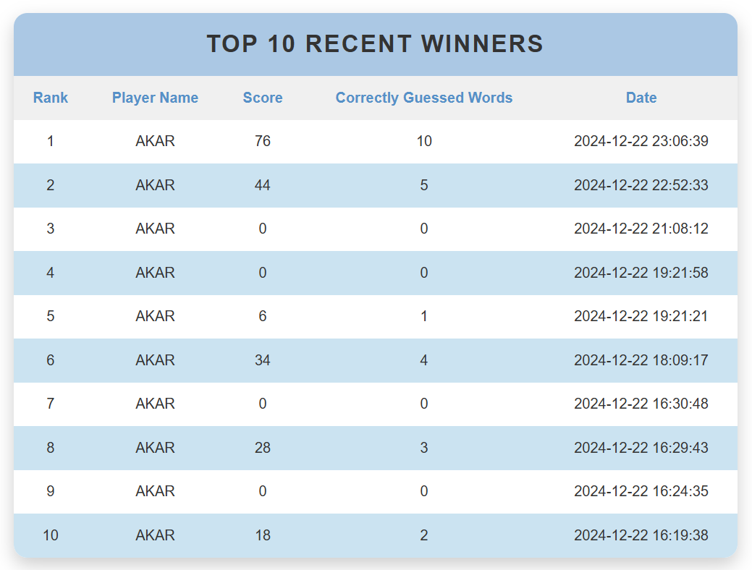
Leaderboard Page & Data Flow
1
Leaderboard Data
2
User’s Last Score
3
Rendering Data with Loops
4
MySQL Database
5
Data Structures Breakdown

Slide 6
Methodology
Approach:
System Design:
Built a modular structure to manage user authentication, gameplay, and leaderboards
Frontend Development:
Designed intuitive interfaces using HTML, CSS, and JavaScript.
Backend Development:
Implemented Flask for server-side logic.
Integrated MySQL for persistent data storage.
Game Logic:
Developed word-guessing mechanics with category and difficulty levels.
Incorporated real-time score tracking and display.
Workflow:
Users log in or sign up.
Select game preferences (category, difficulty).
Play the game with live feedback on correct/incorrect guesses.
Scores and progress are stored and reflected in the leaderboard.

Slide 7
Used Data Structures and Algorithms
Hash Tables:
Usage: Store and retrieve user credentials securely in the database.
Benefit: Enables fast lookup for authentication during login and signup.
Queues:
Usage: Manage the sequence of words for gameplay.
Benefit: Ensures words are presented in order using dequeuing.
Arrays:
Usage:
Store user inputs during login/signup.
Maintain the current state of the guessed word.
Benefit: Simplifies data handling for dynamic updates.
Sets:
Usage: Track unique guessed letters.
Benefit: Prevents duplicate guesses, improving game accuracy.
Algorithms:
Word Selection:
Retrieve random words from the database based on the selected category and difficulty.
Score Calculation:
Calculate points dynamically based on word difficulty and accuracy of guesses.
MySQL Database:
Usage: Store persistent data such as user credentials, scores, and game history.
Benefit: Ensures structured storage and retrieval for scalability.

Slide 8
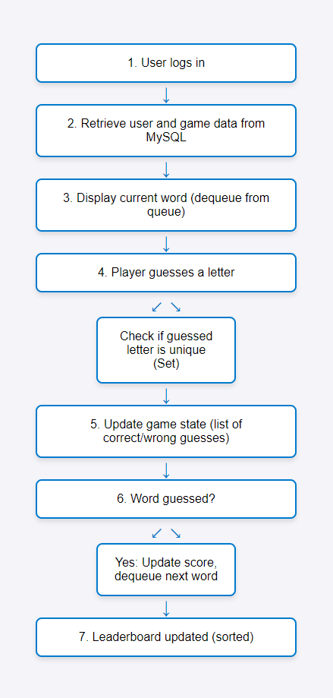
Flow Chart

Slide 9
Future Work
We plan to expand the game into a real-time multiplayer experience, enabling multiple users to play online simultaneously. This will include implementing WebSocket-based real-time synchronization, developing multiplayer game logic, creating user matching and lobbies, and enhancing the database for managing game sessions and scores. Additional features, such as leaderboards, in-game chat, and scalability optimizations, will improve user engagement and system performance.

Slide 10




Conclusion
Efficient data structures and algorithms ensure seamless, engaging gameplay.
Secure authentication and a leaderboard enhance user experience.
The project sets a strong foundation for future improvements.

Slide 11
Reference:
McKinney, W. (2017). Python for data analysis: Data wrangling with Pandas, NumPy, and IPython (2nd ed.). O’Reilly Media.
Cormen, T. H., Leiserson, C. E., Rivest, R. L., & Stein, C. (2009). Introduction to algorithms (3rd ed.). MIT Press.
Mitchell, T. M. (1997). Machine learning. McGraw-Hill.
Sebesta, R. W. (2015). Concepts of programming languages (11th ed.). Pearson.
Flanagan, D. (2020). JavaScript: The definitive guide (7th ed.). O’Reilly Media.
Date, C. J. (2019). An introduction to database systems (8th ed.). Addison-Wesley.
Fowler, M. (2019). Refactoring: Improving the design of existing code (2nd ed.). Addison-Wesley.

